Slide 1
Towards Learning of Efficient Solutions for Signal Processing
Andreas Maier
Lehrstuhl für Mustererkennung (Informatik 5),
Friedrich-Alexander-Universität Erlangen-Nürnberg, Germany

Slide 2
Towards Learning of Efficient Solutions for Signal Processing
Introduction
Deep Learning in X-ray Imaging
Using Prior Operators in a Neural Network
Deep Learning Signal Processing
Outlook

Slide 3
DL – Prior Work
[17] Mathias Unberath et al. Deep Learning-based Inpainting for Virtual DSA. 2017 IEEE Nuclear Science Symposium and Medical Imaging Conference Record (NSS/MIC), Atlanta, 21.10-28.10.2017 – Second Place Student Paper Award
[18] Katharina Breininger et al. Intraoperative Stent Segmentation in X-ray Fluoroscopy for Endovascular Aortic Repair. International Journal of Computer Assisted Radiology and Surgery. accepted. 2018

Slide 4
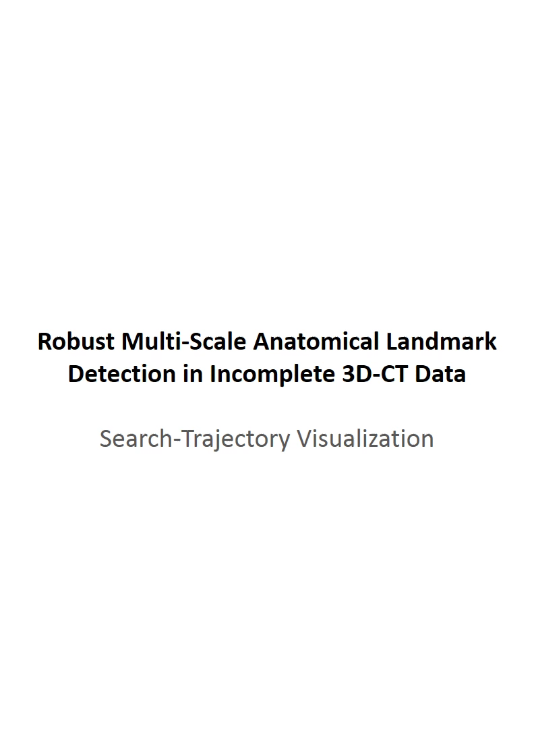
DL – Agent-based Landmark Detection
[19] Florin Ghesu et al. Robust Multi-Scale Anatomical Landmark Detection in Incomplete 3D-CT Data. Medical Image Computing and Computer-Assisted Intervention MICCAI 2017 (MICCAI), Quebec, Canada, pp. 194-202, 2017 – Young Researcher Award
[20] Florin Ghesu et al. Multi-Scale Deep Reinforcement Learning for Real-Time 3D-Landmark Detection in CT Scans. IEEE Transactions on Pattern Analysis and Machine Intelligence. ePub ahead of print. 2018

Slide 5
DL – Multi-Organ Segmentation
[21] Xia Zhong et al. Action Learning for 3D Point Cloud Based Organ Segmentation. GCPR 2018, under review.

Slide 6

DL – Rotation Invariant Landmarks
[22] Bastian Bier et al. X-ray-transform Invariant Anatomical Landmark Detection for Pelvic Trauma Surgery. MICCAI 2018, accepted.

Slide 7
DL – Deep Learning Image Reconstruction?
[23] Yixing Huang et al. Some Investigations on Robustness of Deep Learning in Limited Angle Tomography. MICCAI 2018, accepted.

Slide 8
Towards Learning of Efficient Solutions for Signal Processing
Introduction
Deep Learning in X-ray Imaging
Using Prior Operators in a Neural Network
Deep Learning Signal Processing
Outlook

Slide 9
Prior Operators in Neural Networks
"Let’s not reinvent the wheel…"

Slide 10
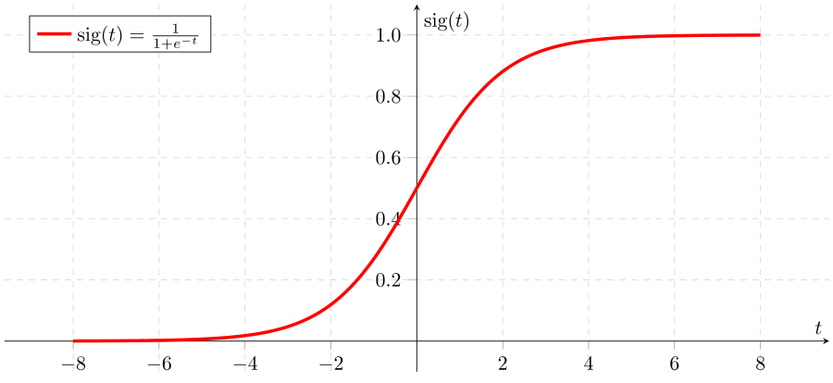
Universal Approximation Theorem
Any continuous function can be approximated by Neural Net
The error is bound by
"Hidden Layer"
…
…
…

Slide 11
Prior Operators
Consider the case of using known operators in the net
Specifically consider the use of two operators in sequence
[24] Andreas Maier et al. Precision Learning: Towards use of known operators in neural networks. ICPR 2018. submitted.

Slide 12
Approximation Sequences
Sequential operations
Can be approximated:

Slide 13
Error of Approximation Sequences
Approximation introduces error
Can we find bounds on this error?

Slide 14
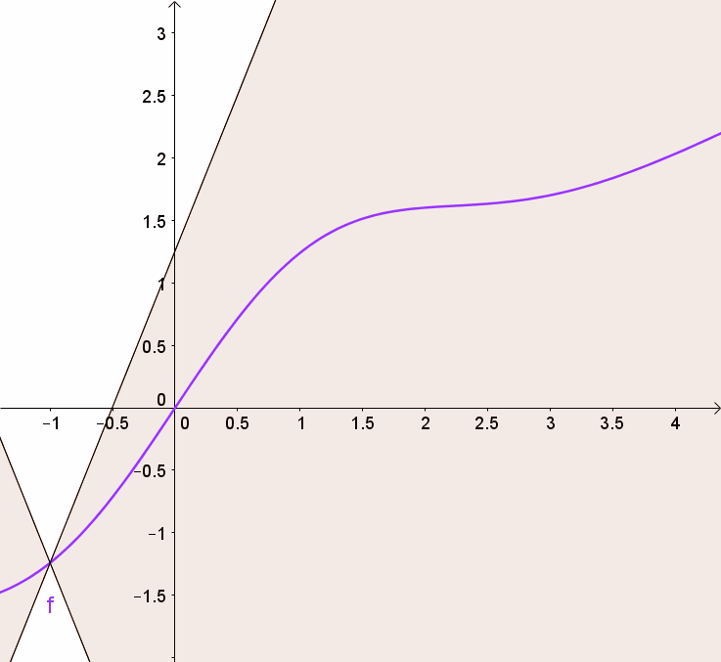
Bounds for Sigmoid Functions
Sigmoid function satisfies the following upper bound:
However this does not hold for linear combinations
Alternate formulation:

Slide 15
Error of Approximation Sequences (2)
Recall
Subtraction of F(x) yields
Which is bounded by

Slide 16
Error of Approximation Sequences (3)
Same idea can also be used for lower bound
Thus a general bound is
Error U(x)
Error G(x)

Slide 17
Observations on Bounds
Bound on Error:
Observations
Error in U(x) and G(x) additive
Error of U(x) amplified by g(x)
Interpretation as Feature Extractor => Importance of Features
Requires Lipschitz continuity
Error U(x)
Error G(x)

Slide 20
[24] Andreas Maier et al. Precision Learning: Towards use of known operators in neural networks. ICPR 2018. submitted.

Slide 21
Towards Learning of Efficient Solutions for Signal Processing
Introduction
Deep Learning in X-ray Imaging
Using Prior Operators in a Neural Network
Deep Learning Signal Processing
Outlook

Slide 22
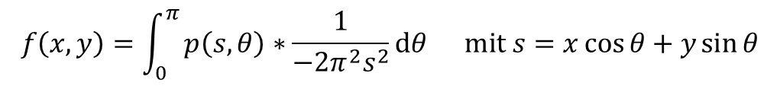
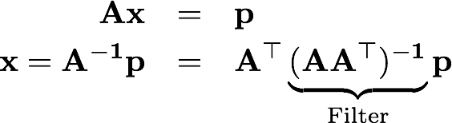
Computed Tomography
Efficient solution via filtered back-projection
Can also be derived in matrix notation:

Slide 23
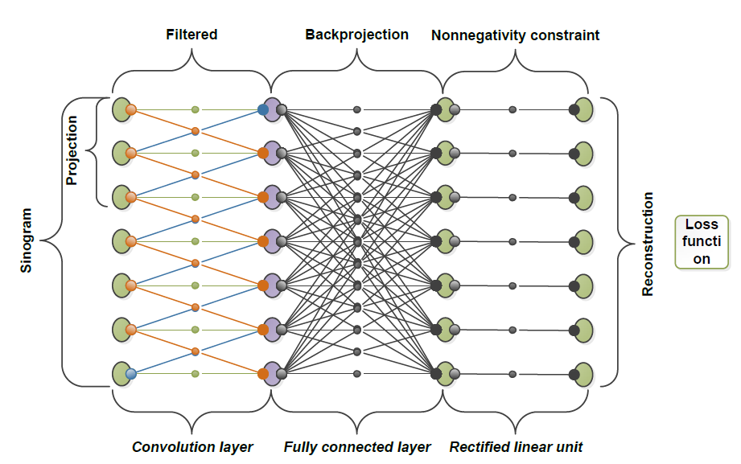
Computed Tomography using Neural Networks
All three steps can be modeled as neural network:
All weights are known from FBP
Operator A does not fit into memory => compute on-the-fly
Loss function
(FCL)

Slide 24
Discretization (2)
Implementation by the book:
[26] Christopher Syben et al. A Deep Learning Approach for Reconstruction Filter Kernel Discretization. CT Meeting 2018. Accepted

Slide 25
Discretization (2)
Implementation by the book:
[26] Christopher Syben et al. A Deep Learning Approach for Reconstruction Filter Kernel Discretization. CT Meeting 2018. Accepted

Slide 26
Discretization (2)
Implementation by the book:
[26] Christopher Syben et al. A Deep Learning Approach for Reconstruction Filter Kernel Discretization. CT Meeting 2018. Accepted

Slide 27
Discretization (2)
Implementation by the book:
[26] Christopher Syben et al. A Deep Learning Approach for Reconstruction Filter Kernel Discretization. CT Meeting 2018. Accepted

Slide 28
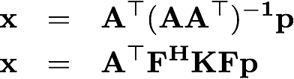
Discretization (3)
Idea: Neural Networks are discrete end-to-end
=> Network must learn correct solution
Correct discretization is an intrinsic property of the net

Slide 29
Discretization (3)
Idea: Neural Networks are discrete end-to-end
=> Network must learn correct solution
Correct discretization is an intrinsic property of the net
Net

Slide 30
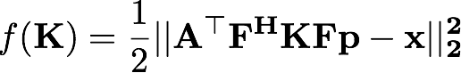
Discretization (3)
Idea: Neural Networks are discrete end-to-end
=> Network must learn correct solution
Correct discretization is an intrinsic property of the net
Associated optimization problem:

Slide 31
Discretization (3)
Objective function:

Slide 32
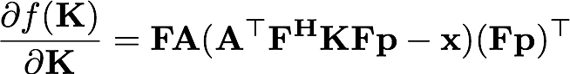
Discretization (3)
Objective function:
Gradient:

Slide 33
Discretization (3)
Objective function:
Gradient:
Recon

Slide 34
Discretization (3)
Objective function:
Gradient:
Error

Slide 35
Discretization (3)
Objective function:
Gradient:
Error
Backpropagation

Slide 36
Discretization (3)
Objective function:
Gradient:
Backpropagation

Slide 37
Discretization (3)
Objective function:
Gradient:
Backpropagation
„l-1“

Slide 38
Discretization (3)
Objective function:
Gradient:
Backpropagation
„l-1“

Slide 39
Discretization (3)
Filter after "Learning":
[26] Christopher Syben et al. A Deep Learning Approach for Reconstruction Filter Kernel Discretization. CT Meeting 2018. Accepted

Slide 40
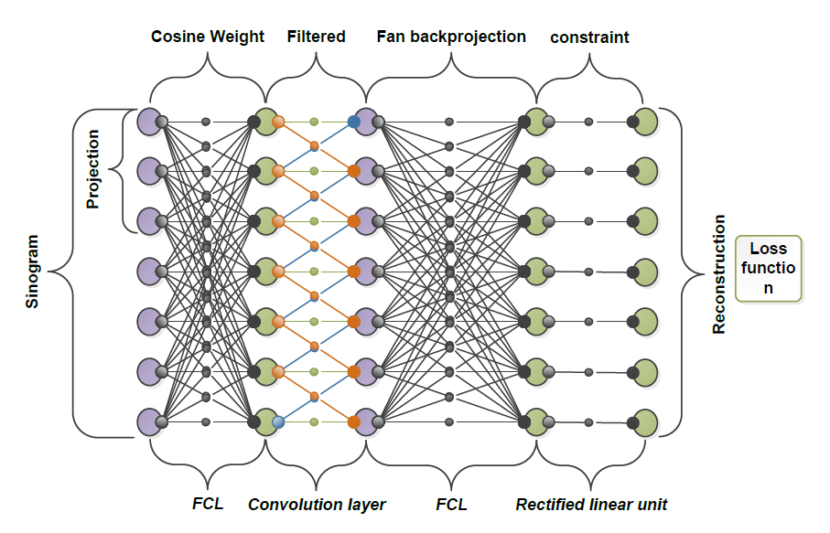
Computed Tomography using Neural Networks
Embedding of "heuristics" for artifact reduction possible by learning
Loss function
Mult

Slide 41
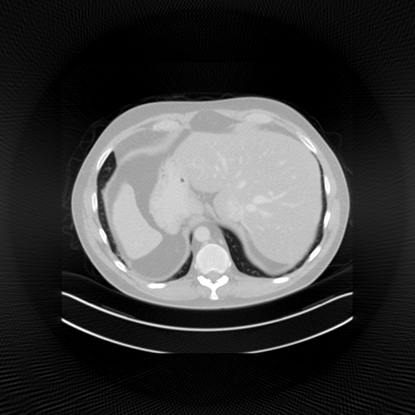
Computed Tomography using Neural Networks
Application to incomplete scans [2]
Reconstruction with 360 deg
[27] Tobias Würfl, Florin Ghesu, Vincent Christlein, Andreas Maier. Deep Learning Computed Tomography. MICCAI 2016.

Slide 42
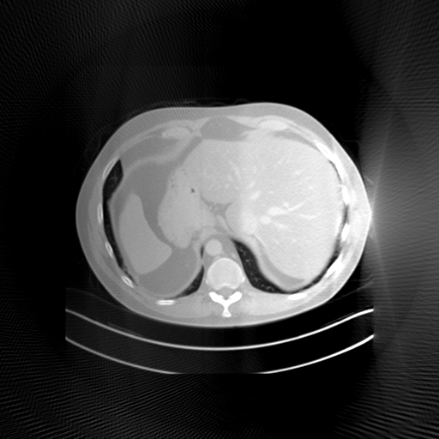
Computed Tomography using Neural Networks
Application to incomplete scans [2]
Reconstruction with 180 deg (FBP)
[27] Tobias Würfl, Florin Ghesu, Vincent Christlein, Andreas Maier. Deep Learning Computed Tomography. MICCAI 2016.

Slide 43
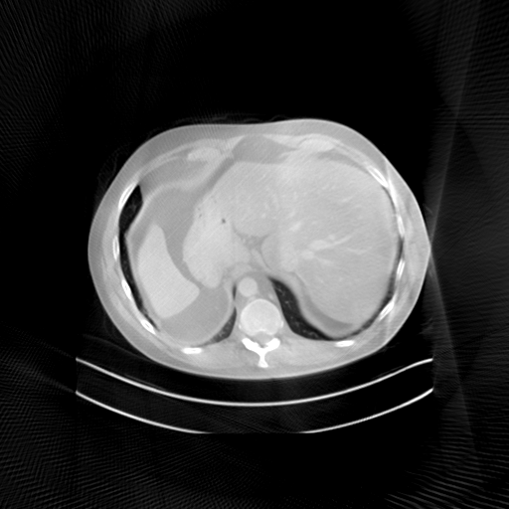
Computed Tomography using Neural Networks
Application to incomplete scans [2]
Reconstruction with 180 deg (NN)
[27] Tobias Würfl, Florin Ghesu, Vincent Christlein, Andreas Maier. Deep Learning Computed Tomography. MICCAI 2016.

Slide 44
Learned Weights
Parker et al.
Schäfer et al.
N. N. et al.
[27] Tobias Würfl, Florin Ghesu, Vincent Christlein, Andreas Maier. Deep Learning Computed Tomography. MICCAI 2016.

Slide 45
Further Extensions
Add non-linear de-streaking and de-noising step:
[28] Kerstin Hammernik et al. A Deep Learning Architecture for Limited-Angle Computed Tomography Reconstruction. BVM 2016.

Slide 46
Further Extensions
Add non-linear de-streaking and de-streaking step:
[28] Kerstin Hammernik et al. A Deep Learning Architecture for Limited-Angle Computed Tomography Reconstruction. BVM 2016.

Slide 47
Further Extensions

Slide 48
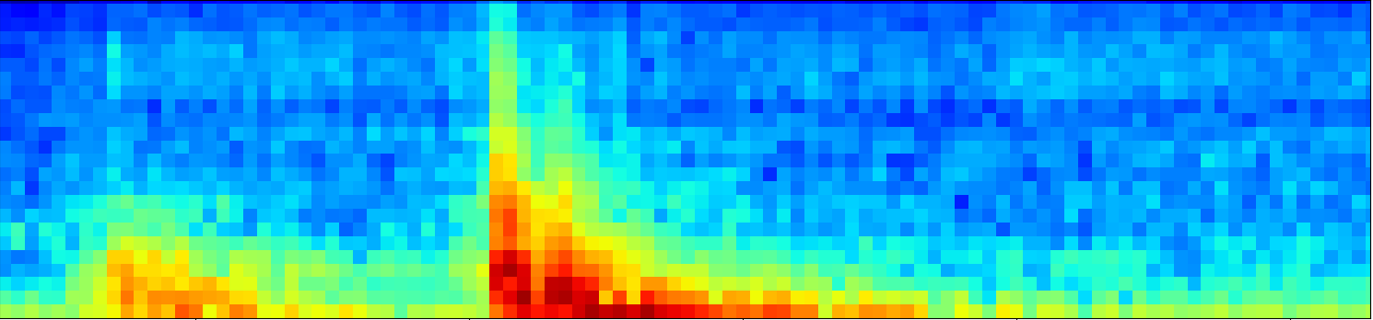
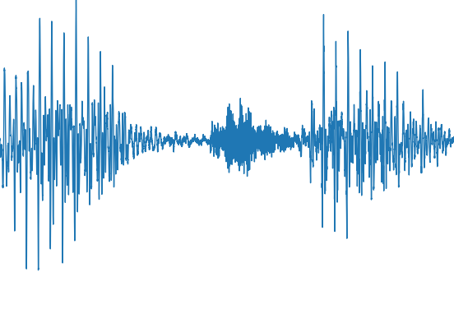
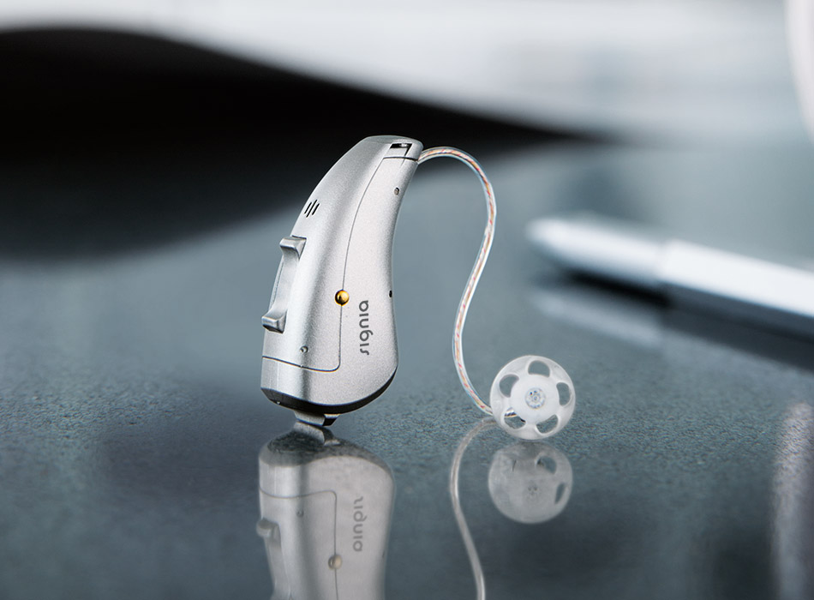
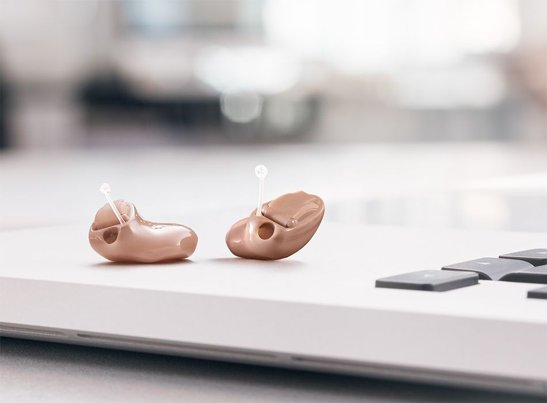
Simplified Modern Hearing Instrument Pipeline
AFB
-
Directional Microphone
Noise Reduction
AGC
SFB
-
AFB
FBC
AFB
AFB = Analysis Filterbank
AGC = Automatic Gain Control
SFB = Synthesis Filterbank
FBC = Feedback Canceler
Images from Carat&Insio (cropped)
Used with permission from Kai Ehrensperger and Marc Aubreville

Slide 49
Network-Architecture
48-channel
analysis filter bank
DNN
48-channel synthesis
filter bank
×
Dense Neural Network (DNN)
Network input:
200 frames from past
current frame
2 frames from future → delay of 2 ms + filter bank delay
normalized to zero-mean & unit variance frequency-bin-wise
3 hidden layer /w 2048 hidden nodes + ReLU
Network output:
current frame (=48 nodes) + Sigmoid
prediction of wiener gain
Used with permission from Kai Ehrensperger and Marc Aubreville

Slide 50
Network-Architecture
7714 input
3x 2048 hidden
+ ReLU
48 output
+ sigmoid
normalized
...
wiener gain
fully connected
Used with permission from Kai Ehrensperger and Marc Aubreville

Slide 51
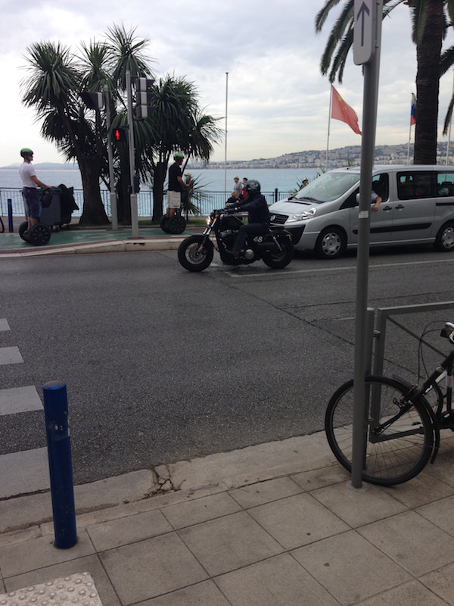
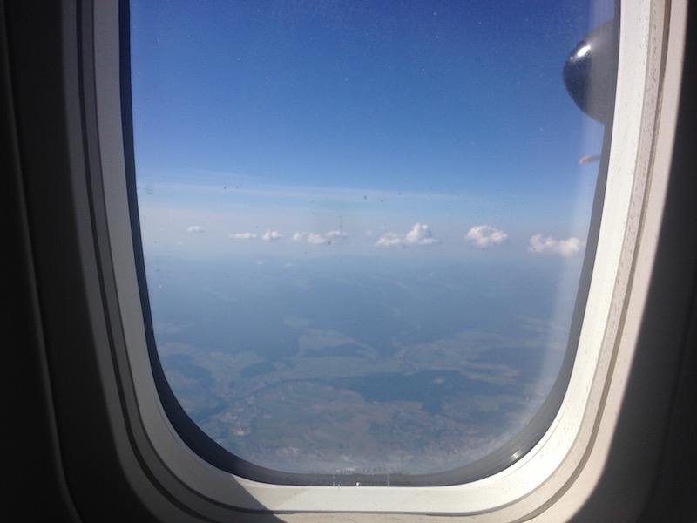
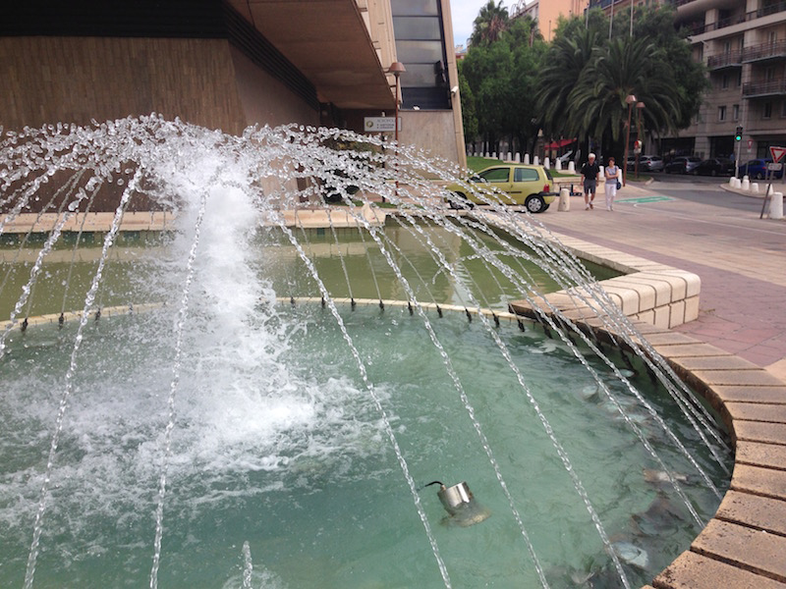
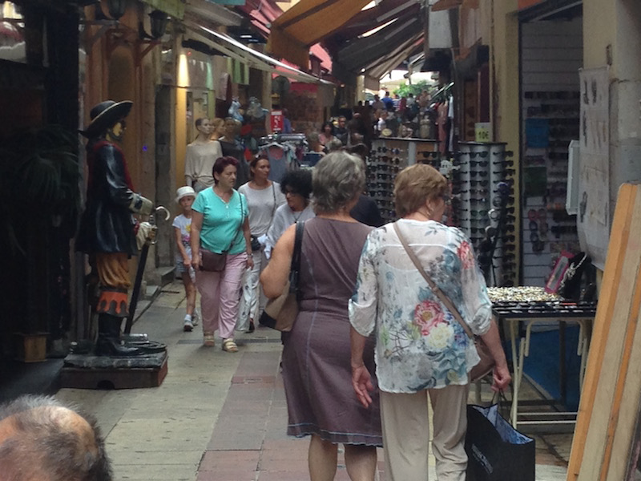
Dataset
Database (fs=24kHz):
259 clean speech signals:
expected duration: 21 s
48 non-stationary noise signals
expected duration: 118 s

Slide 52
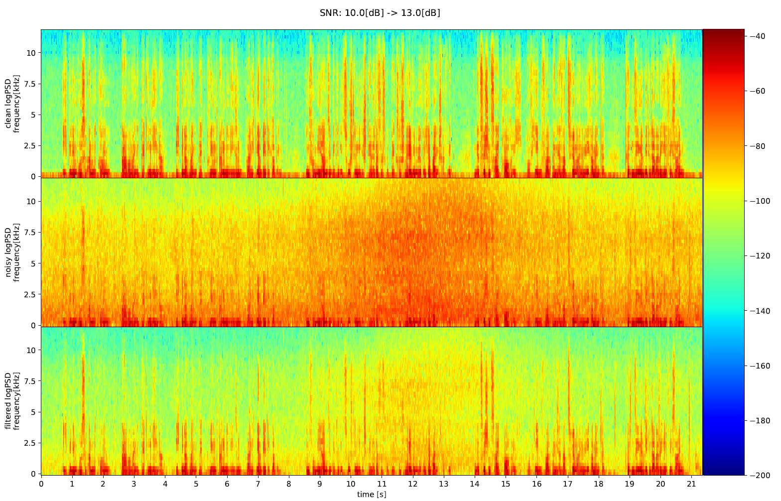

Filtered Examples
Results
SNR: 10 → 13 dB
clean
noisy
filtered
Used with permission from Kai Ehrensperger and Marc Aubreville

Slide 53
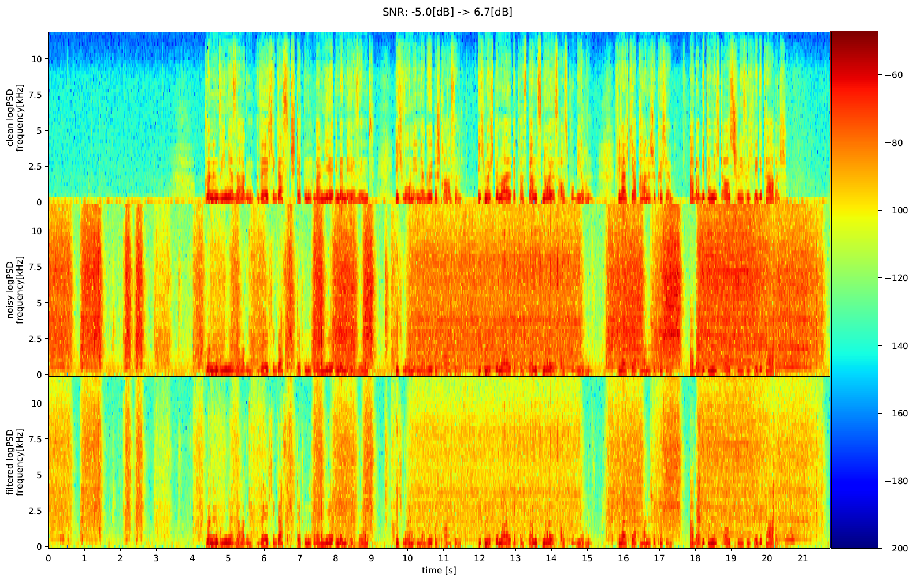
Filtered Examples
Results (2)
SNR: -5 → 6.7 dB
clean
noisy
filtered
Used with permission from Kai Ehrensperger and Marc Aubreville

Slide 54
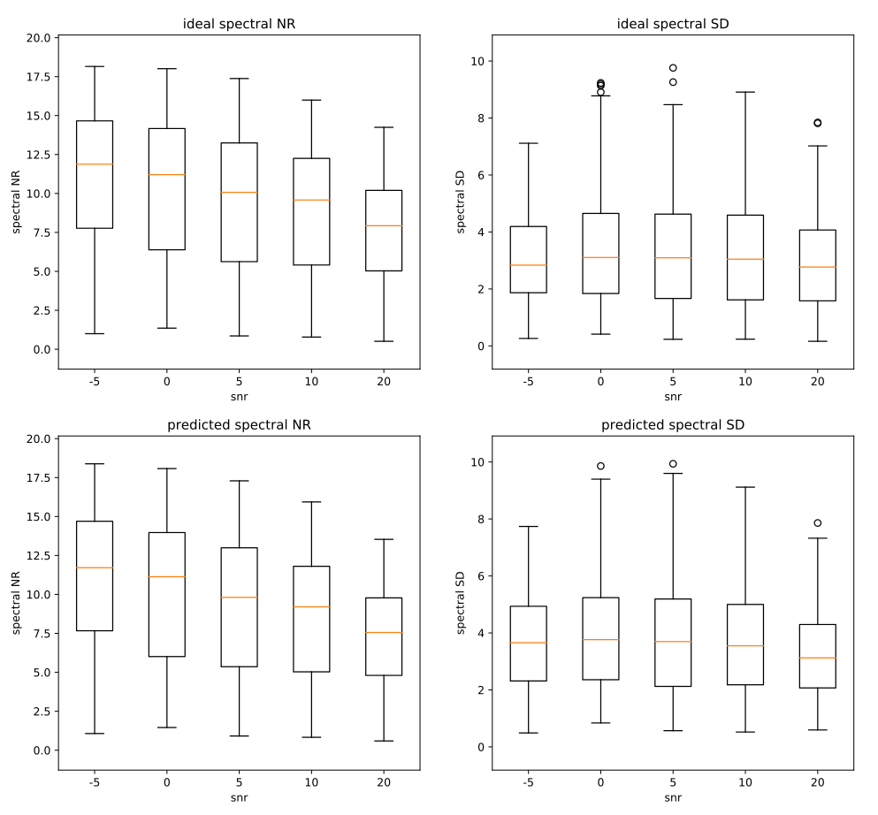
Results (3)
Used with permission from Kai Ehrensperger and Marc Aubreville

Slide 55
Deep Learning Signal Processing
Filtered back-projection approach mathematically equivalent to neural network and vice versa
Learned algorithm is again an FBP algorithm
Learned parameters can be interpreted!
Iterative, regularized approaches can also be integrated
Highly efficient decoding / reconstruction

Slide 56
Towards Learning of Efficient Solutions for Signal Processing
Introduction
Deep Learning in X-ray Imaging
Using Prior Operators in a Neural Network
Deep Learning Signal Processing
Outlook

Slide 57
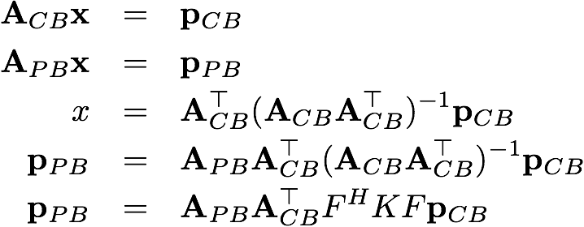
Can we „derive“ networks?

Slide 58
Can we „derive“ networks?
Cone-beam acquisition

Slide 59
Can we „derive“ networks?

Slide 60
Can we „derive“ networks?
Parallel projection

Slide 61
Can we „derive“ networks?
Parallel projection
Can’t be measured!

Slide 62
Can we „derive“ networks?

Slide 63
Can we „derive“ networks?

Slide 64
Can we „derive“ networks?

Slide 65
Can we „derive“ networks?
New Net
Topology ?

Slide 66
Can we „derive“ networks?
New Net
Topology ?
Non-linear formulas can also be approximated!

Slide 67
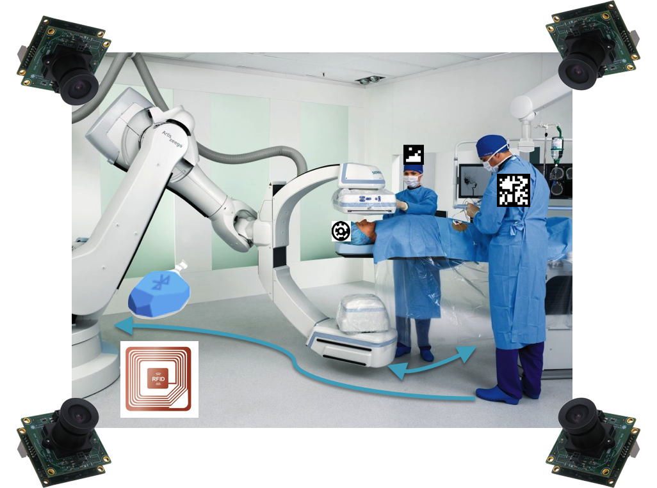
Outlook – Smart OR

Slide 68
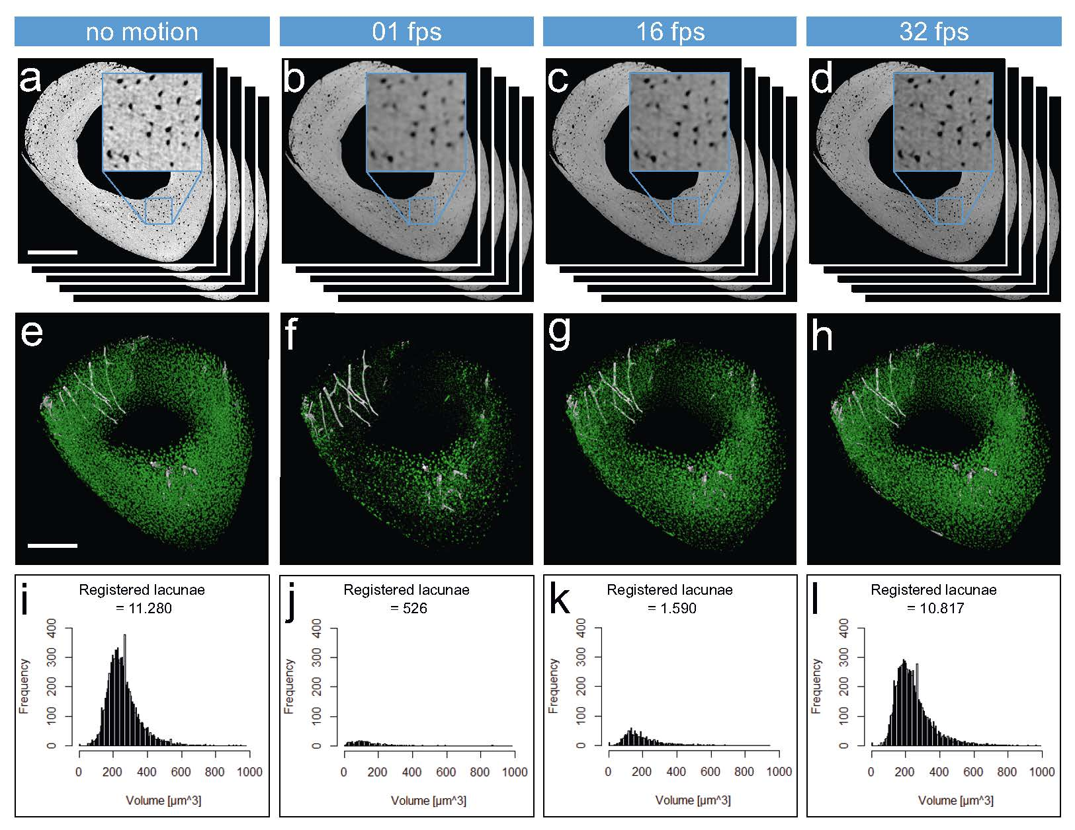
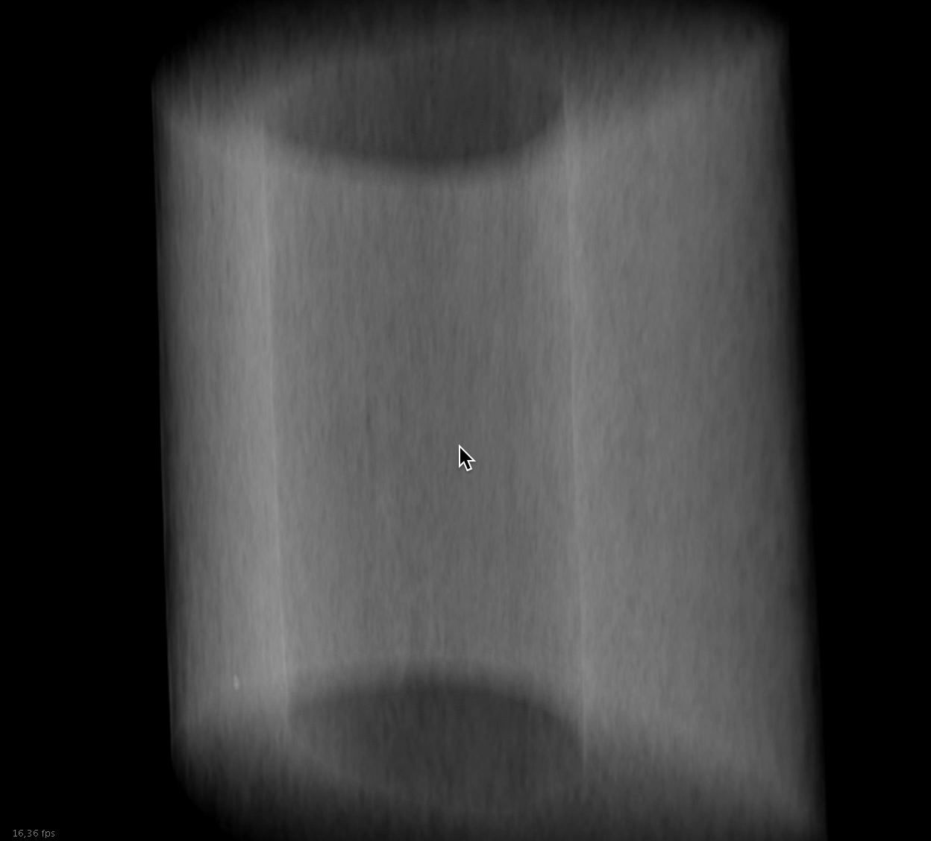
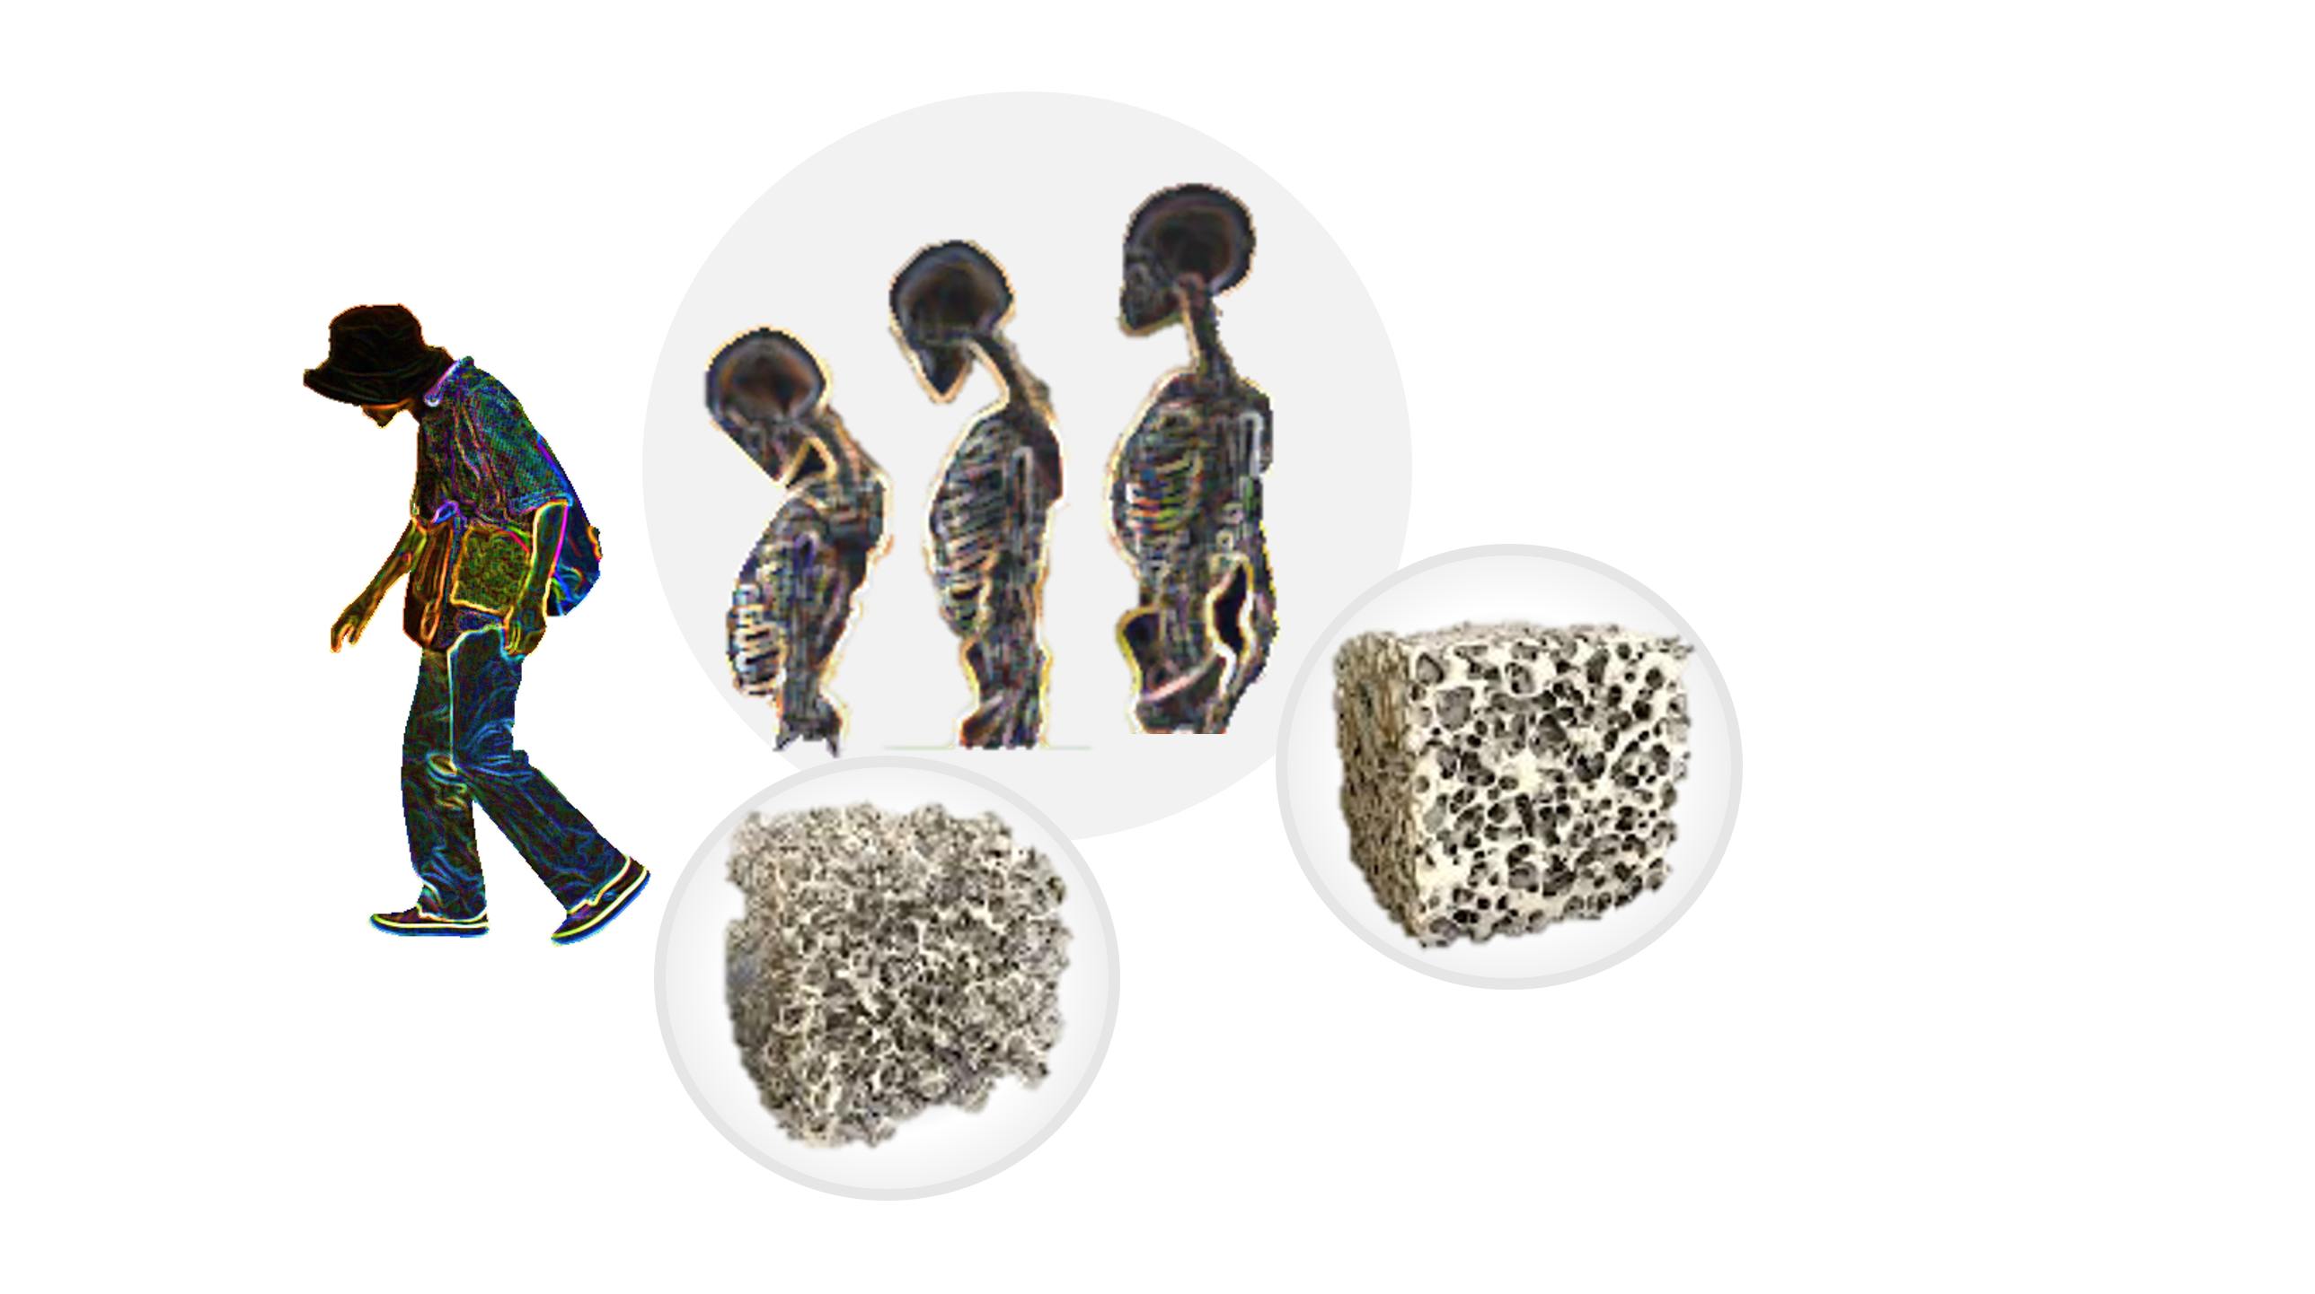
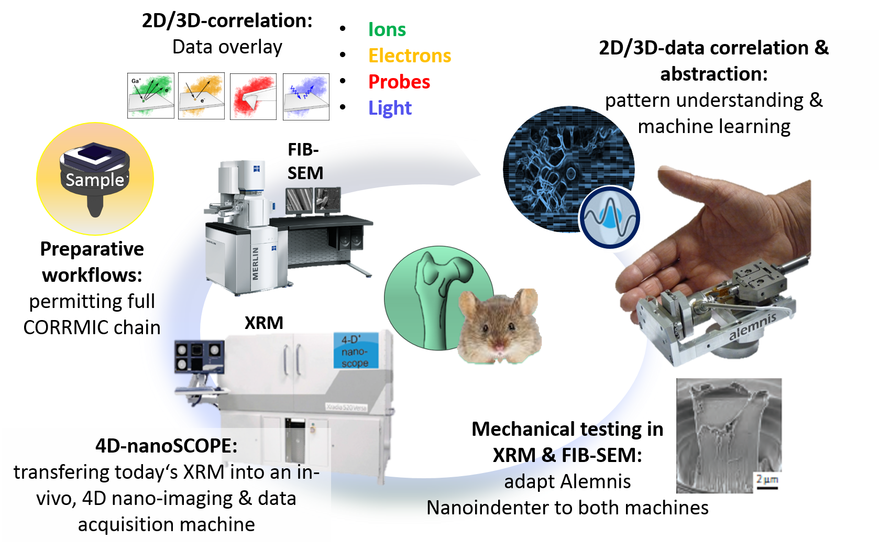
Outlook – Tasked-oriented Imaging

Slide 69
Summary
Introduction Pattern Recognition Lab
DL Applications in X-ray Imaging
Prior Operators in Neural Networks
Lessons "learned“:
Material Decomposition
Discretization
Limited Angle
Streak Supression
Hearing Aid
Neural networks are compatible with traditional techniques!
Outlook
More applications!
Better understanding of the "black box"

Slide 70
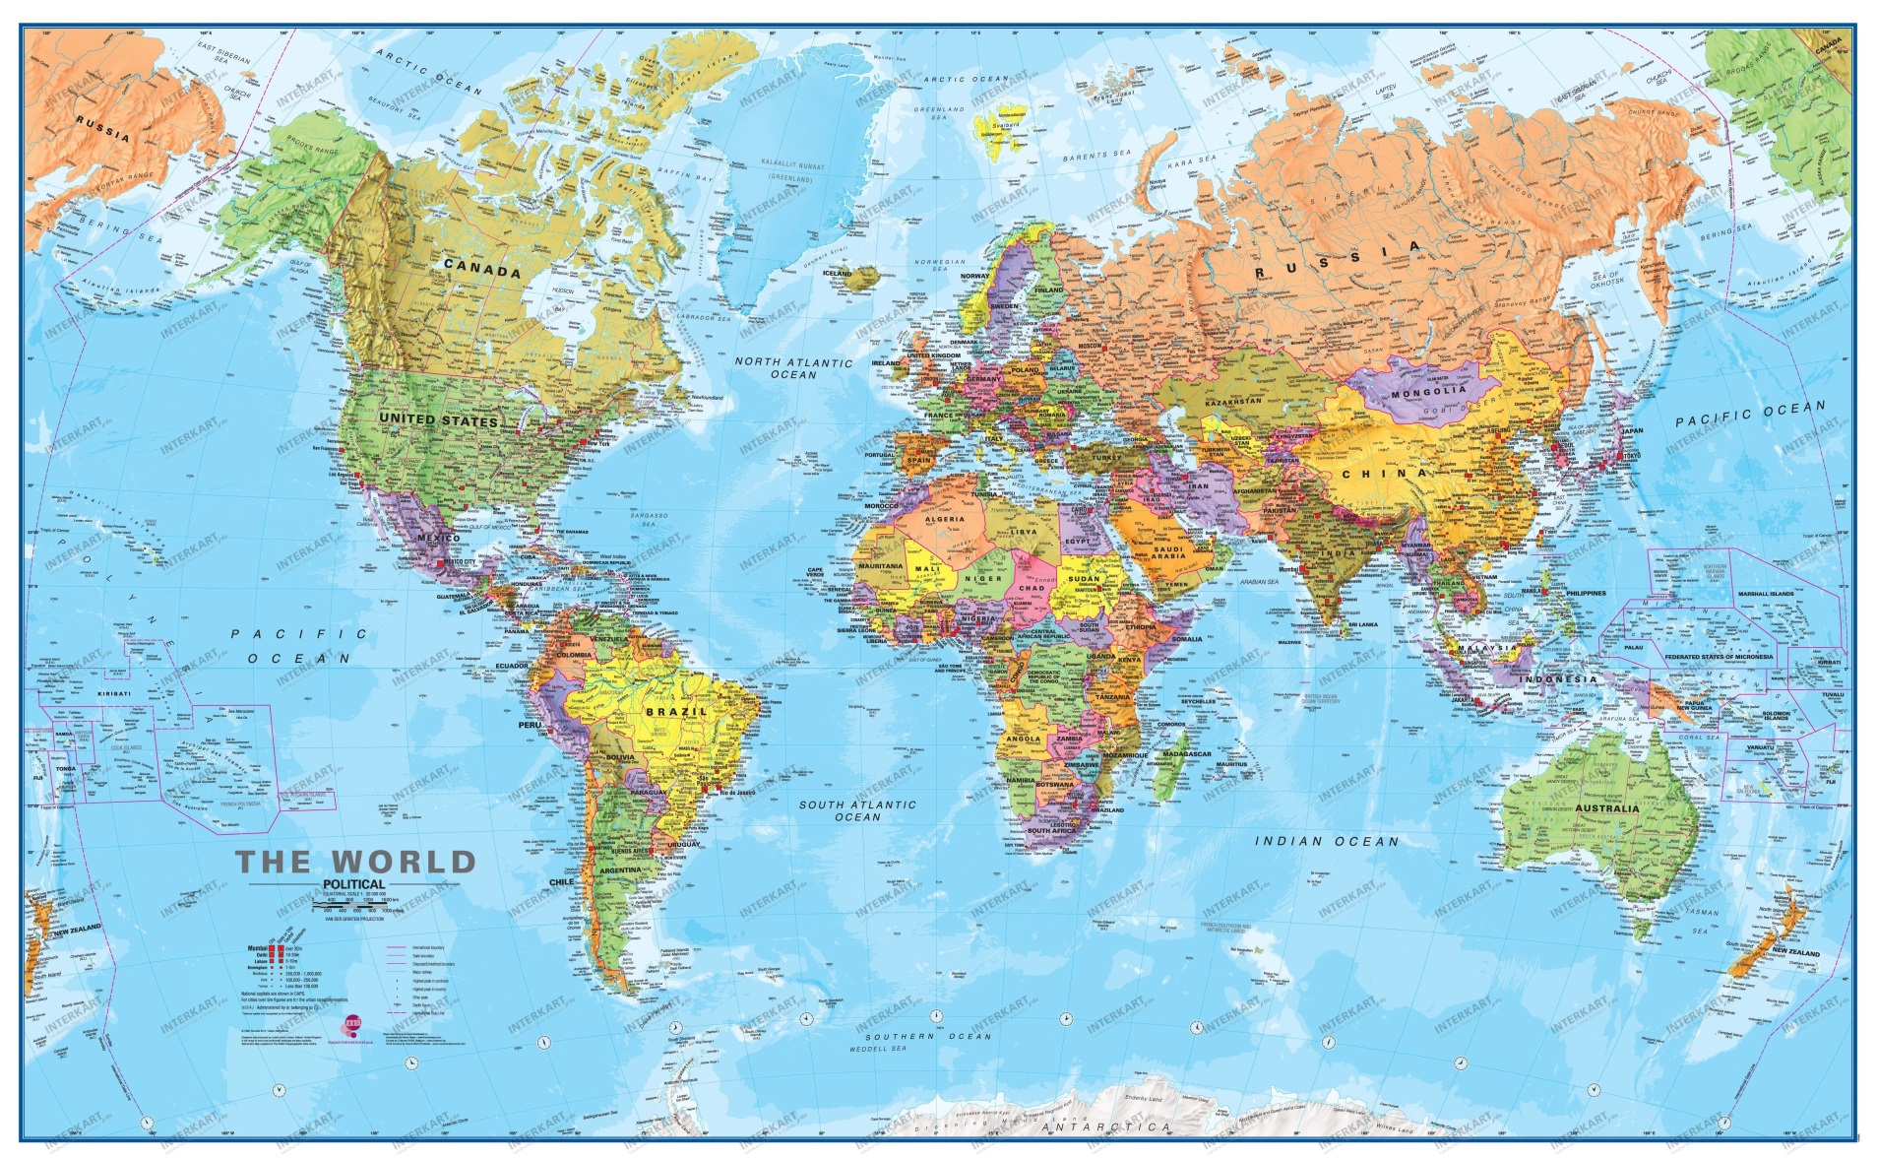
Cooperations

Slide 71
Thank you for your attention!
[1] Yan Xia at al. Patient-bounded extrapolation using low-dose priors for volume-of-interest imaging in C-arm CT. Medical Physics, vol. 42, no. 4, pp. 1787-1796, 2015
[2] Yanye Lu et al. Projection-Based Denoising Method for Photon-Counting Energy-Resolving Detectors. BVM 2015, Lübeck, Germany, 15 - 17 March 2015, pp. 137-142, 2015
[3] Yanye Lu et al. Material Decomposition Using Ensemble Learning for Spectral X-ray Imaging. IEEE Transactions on Radiation and Plasma Medical Sciences. ePub ahead of print
[4] Moiz Ahmad et al. First in-vivo Experiments with Large field-of-view Flat Panel Photon-Counting Detector. CT Meeting 2016, Bamberg, Germany, 18.07.-22.07.2016, pp. 105-108, 2016
[5] Florian Bayer et al. Reconstruction of scalar and vectorial components in X-ray dark-field tomography. PNAS, vol. 111, pp. 12699-12704, 2014
[6] Bastian Bier et al. Scatter correction using a primary modulator on a clinical angiography C-arm CT system. Medical Physics, vol. 44, no. 9, pp. e125-e137, 2017 – Featured on Cover of Medical Physics
[7] Oliver Taubmann et al. Coping with Real World Data: Artifact Reduction and Denoising for Motion-Compensated Cardiac C-arm CT. Medical Physics, vol. 43, no. 2, pp. 883-893, 2016
[8] Jang-Hwan Choi et al. Fiducial marker-based correction for involuntary motion in weight-bearing C-arm CT scanning of knees. Part I. Numerical model-based optimization. Medical Physics, vol. 40, no. 9, pp. 091905-1-12, 2013
[9] Jang-Hwan Choi et al. Fiducial marker-based correction for involuntary motion in weight-bearing C-arm CT scanning of knees. II. Experiment. Medical Physics, vol. 41, no. 6, pp. 061902, 2014
[10] Martin Berger et al. Marker-free motion correction in weight-bearing cone-beam CT of the knee joint. Medical Physics, vol. 43, no. 3, pp. 1235-1248, 2016
[11] Zhicong Yu et al. Axially Extended-Volume C-Arm CT Using a Reverse Helical Trajectory in the Interventional Room. IEEE Transactions on Medical Imaging, vol. 1, no. 34, pp. 203-215, 2015
[12] Daniel Stromer et al. Comparison of SART and eTV Reconstruction for increased C-arm CT Volume Coverage by proper Detector Rotation in Liver Imaging. Proceedings of the 2016 IEEE International Symposium on Biomedical Imaging 2016, pp. 589-592, 2016
[13] Martin Berger et al. Motion Compensation for Cone-Beam CT Using Fourier Consistency Conditions. Physics in Medicine and Biology, vol. 62, no. 17, pp. 7181-7215, 2017 – PMB Featured Article

Slide 72
Thank you for your attention! (2)
[14] Mathias Unberath et al. Consistency-based respiratory motion estimation in rotational angiography. Medical Physics, vol. 44, no. 9, pp. e113-e124, 2017 – Featured on Cover of Medical Physics
[15] Andreas Maier et al. CONRAD - A software framework for cone-beam imaging in radiology. Medical Physics, vol. 40, no. 11, pp. 111914, 2013
[16] Daniel Stromer et al. Browsing Through Closed Books: Fully Automatic Book Page Extraction from a 3-D X-ray CT Volume. The 14th IAPR International Conference on Document Analysis and Recognition (2017 14th IAPR International Conference on Document Analysis and Recognition), Kyoto, Japan, 09.11 - 15.11.2017, pp. 224-229, 201
[17] Mathias Unberath et al. Deep Learning-based Inpainting for Virtual DSA. 2017 IEEE Nuclear Science Symposium and Medical Imaging Conference Record (NSS/MIC), Atlanta, 21.10-28.10.2017 – Second Place Student Paper Award
[18] Katharina Breininger et al. Intraoperative Stent Segmentation in X-ray Fluoroscopy for Endovascular Aortic Repair. International Journal of Computer Assisted Radiology and Surgery. Under minor revision. 2018
[19] Florin Ghesu et al. Robust Multi-Scale Anatomical Landmark Detection in Incomplete 3D-CT Data. Medical Image Computing and Computer-Assisted Intervention MICCAI 2017 (MICCAI), Quebec, Canada, pp. 194-202, 2017 – MICCAI Young Researcher Award
[20] Florin Ghesu et al. Multi-Scale Deep Reinforcement Learning for Real-Time 3D-Landmark Detection in CT Scans. IEEE Transactions on Pattern Analysis and Machine Intelligence. ePub ahead of print. 2018
[21] Xia Zhong et al. Action Learning for 3D Point Cloud Based Organ Segmentation. MICCAI 2018, under review.
[22] Bastian Bier et al. X-ray-transform Invariant Anatomical Landmark Detection for Pelvic Trauma Surgery. MICCAI 2018, under review.
[23] Yixing Huang et al. Some Investigations on Robustness of Deep Learning in Limited Angle Tomography. MICCAI 2018, under review.
[24] Andreas Maier et al. Precision Learning: Towards use of known operators in neural networks. ICPR 2018. under review.
[25] Weilin Fu et al. Frangi-Net: A Neural Network Approach to Vessel Segmentation. Proc. Bildverarbeitung für die Medizin 2018, Springer Heidelberg, pp 341-346 – Best Presentation Award
[26] Christopher Syben et al. A Deep Learning Approach for Reconstruction Filter Kernel Discretization. CT Meeting 2018. Accepted
[27] Tobias Würfl, Florin Ghesu, Vincent Christlein, Andreas Maier. Deep Learning Computed Tomography. MICCAI 2016.
[28] Kerstin Hammernik et al. A Deep Learning Architecture for Limited-Angle Computed Tomography Reconstruction. Proc. Bildverarbeitung für die Medizin 2018. Springer Heidelberg.

